Slide 1
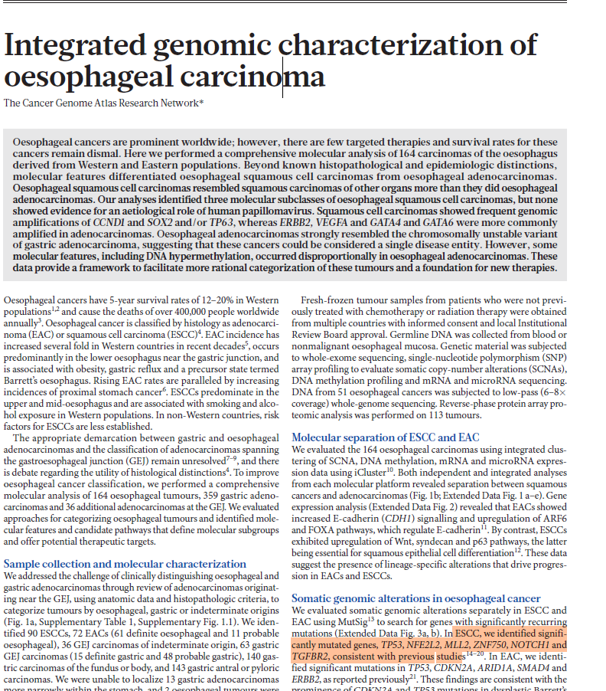

Presented by:
Opeyemi De Campos, Reem Atawia, Antara Ghanta & Ariyo Adesokan M.

Slide 2
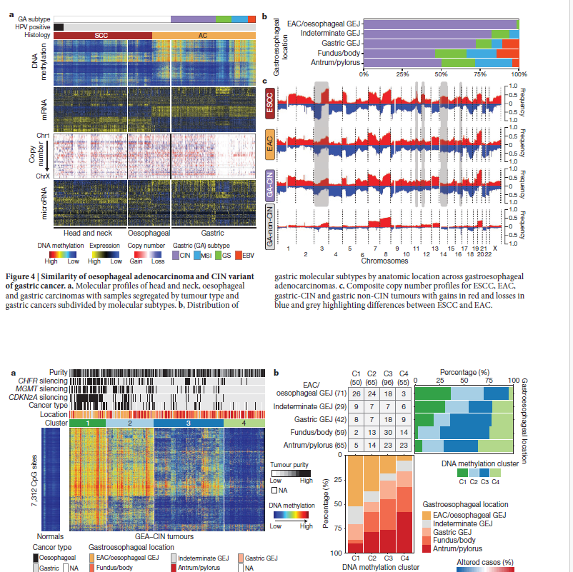

Slide 3
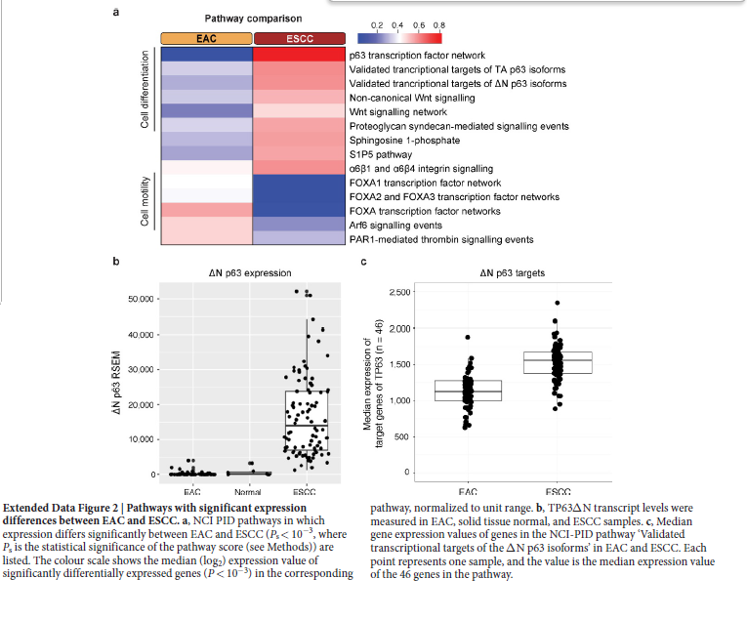

Slide 4
